Slide 1


Slide 2

Introduction to Node.js
Welcome!
Tim Kellogg
Senior Instructor, Pluralsight
Notes:
Mandatory
ACTION: Adjust title to fit your course.

Slide 3

Tim Kellogg
About Me:
Senior Instructor @ Pluralsight
Teaches Full Stack Development
JavaScript / React
Node.js
SQL + MongoDB
Lives in Cleveland, OH (USA)
Loves to travel
Loves to exercise
Notes:
Mandatory
ACTION: Adjust to fit you.
Script: I am [insert name] with DevelopIntelligence. We’re the training partner for [insert client name]. [Provide brief info on your background.]
Wing it!!! Keep it short!!! (Under 2 minutes; less than 1 is even better). Your goal is to establish rapport. You’re just trying to connect with the students. For example...
Here’s a little about my background in case you want this for reference later. Fun fact: [insert a piece of trivia about your personal life…”When I’m not teaching or coding, I am a skydiver”…whatever cool hobby you are engaged in]
Avoid putting your resume here. Say only a sentence or two about your professional credentials and invite them to ask questions about your background or experiences at any point during the training.

Slide 4


Japan!
Notes:
Mandatory
ACTION: Adjust objectives to fit your course.
Use measurable objectives that start with action verbs such as: describe, define, identify, assess, demonstrate, use, utilize. https://elearningindustry.com/writing-learning-objectives-for-elearning-what-elearning-professionals-should-know

Slide 5
Prerequisites
This course assumes you
Have never taken a formal course in Node.js and know little or nothing about the language
Have a desire to learn about Node.js and how to work with web servers
Please note:
If you have prior experience with Node.js or building web servers, this course may cover familiar topics, but it can still be a valuable refresher.
If you think you may be in the wrong place, please chat me so we can get you to the right resource!
Notes:
Mandatory
ACTION: Adjust prerequisites to fit your course. Keep it brief.
Script: Before we start, I want to make sure everyone is in the correct class. Take a look at these prerequisites and message me in Chat if you have questions or aren’t sure you’re in the right spot.

Slide 6
Why study this subject?
To streamline full-stack development: Use the same language for both client and server sides
To build high-performance applications: Exploit its non-blocking, event-driven architecture for scalable solutions
To access a vast library of modules: Take advantage of the extensive npm ecosystem to enhance development
Notes:
Mandatory
ACTION: Adjust benefits to fit your course.
Examples...
You’ll be learning Python so that you can work on XYZ project…

Slide 7






































We teach over 400 technology topics.
Notes:
Mandatory
Script: Pluralsight teaches a lot of different tech. If there’s a technology you want to learn and you don’t see it in your company’s learning catalog, let your manager know. We’d be glad to help.”

Slide 8



You experience our impact on a daily basis!
Notes:
Mandatory
Script: In your everyday life, you come across tech many times a day. When you shop online. When you pay for your morning coffee. When you watch a movie or travel. We train software developers and IT professionals who work on many of the products and services you use daily.
In fact, when you talk on the phone, watch a movie, connect with friends on social media, drive a car, fly on a plane, shop online, and order a latte with your mobile app, you are experiencing the impact of our solutions.

Slide 9
My pledge to you:
I will..
Make this course interactive
Ask you questions
Ensure everyone can speak
Create an inclusive learning environment
Give ample opportunities for breaks
…also, if you have an accessibility need, please let me know!
Notes:
Mandatory
Script: This is my pledge to you. I’d like to talk in particular about the third bullet. Sometimes in a class, an enthusiastic participant will want to speak out in every discussion, answer every question and so forth. I want to make sure all of you have the opportunity to be heard. So, if I haven’t heard from you in awhile, I may call on you or check in via chat, because I want to make sure everyone gets their questions answered. Also, I want to demonstrate the timer and confirm that everyone can see it. EggTimer is a good timer - https://e.ggtimer.com/

Slide 10
Objectives
At the end of this course, you will be able to:
Describe how Node works
Build command line apps with Node
Utilize the core Node package modules within npm
Create basic Express apps
Create basic SocketIO apps
Notes:
Mandatory
ACTION: Adjust objectives to fit your course.
Use measurable objectives that start with action verbs such as: describe, define, identify, assess, demonstrate, use, utilize. https://elearningindustry.com/writing-learning-objectives-for-elearning-what-elearning-professionals-should-know

Slide 11
Introduction
What is Node.js?
Lab Environment Login / Config
Hands-on with Node.js
Notes:
Mandatory
ACTION: Adjust agenda as per your course.
The agenda provides students a roadmap of where the class is going and what is coming up. Keep it high level, as there is no need to include “Gazornin” in the agenda if that’s something they don’t understand. Refer to the agenda at the beginning of the class, at the end of every day and at the beginning of every morning. In the mornings, the Agenda is a great way to facilitate a Q&A session about what was covered on the previous day.

Slide 12
How we’re going to work together
You’ll have a copy of all the course materials shortly
Materials are accessible on GitHub
Download includes slides, demos, and exercises
You’ll be following along as I introduce and demo new concepts before working through the exercises in small groups
Use the examples in the provide demos directory to assist you
I will also be coming through breakouts to offer support
Notes:
Mandatory
ACTION: Adjust bullets as per your course.
In this section, discuss the structure of the course—exercises, labs, etc.
Also, discuss any resources students will be using.

Slide 13
Student Instructions
Job title?
Where are you based?
Any Node / JavaScript experience?
Some place you want to travel to OR Some place you recently traveled to
Your name?
Notes:
Optional, because you may already plan to do this in your own materials…
ACTION: We want to be sure you take time to have the students introduce themselves. It could happen here, or it could happen at the start of your materials.

Slide 14

Thank you!
If you have any additional questions, please ask!
Notes:
Mandatory -- Need bookend -- first and last thing they should see is Pluralsight.
ACTION: Use this for the final slide of your class materials. Include contact information so participants can reach you if they have questions after the course.

Slide 15
What is Node.js?
JavaScript cross-platform, open-source runtime built on Chrome's V8 JavaScript engine
Allows developers to use JavaScript for server-side scripting
Designed to build scalable network applications

Slide 16
What is JavaScript?
High-level, dynamic, and interpreted programming language used both client-side and server-side
Supports event-driven, functional, and imperative programming styles.
Widely used for building interactive websites, with capabilities expanded to server-side development through environments like Node.js.

Slide 17
What is a scalable network application?
Designed to handle a growing amount of work by adding resources to the system
Efficiently manages multiple simultaneous connections with minimal overhead
Utilizes non-blocking, event-driven architecture to handle thousands of concurrent connections on a single server

Slide 18
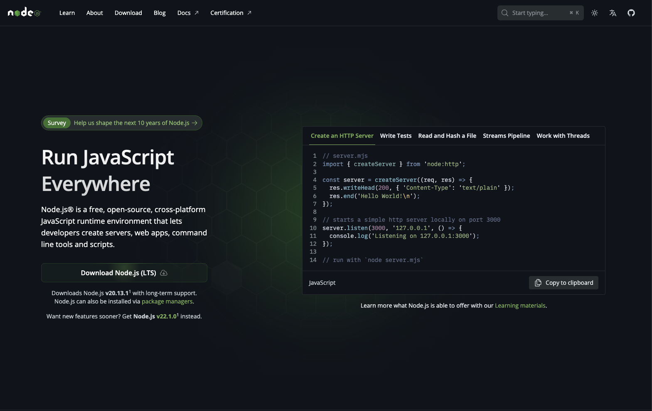
Time to get our hands dirty!

